Slide 1


Power BI Masterclass
Prasad Weerasekara
Senior consultant – Business Intelligence
BSc (Data Science), University of Peradeniya
MSc (Artificial Intelligence), University of Moratuwa

Slide 2
Course Overview
Data Modeling Concepts
DAX with Practical Examples

Slide 3
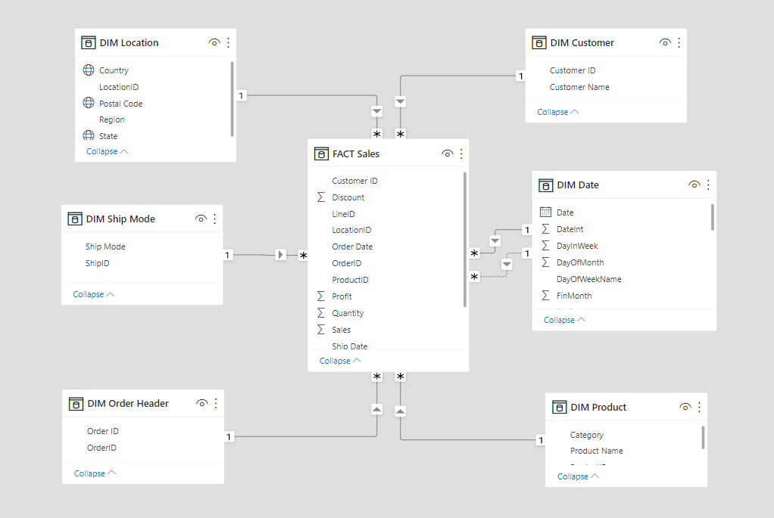
Designing a Data Model
Define Tables
Fact tables
Dimension Tables
Build Relationships
One-to-many
From dimension to fact
Single directional
Star schema

Slide 4
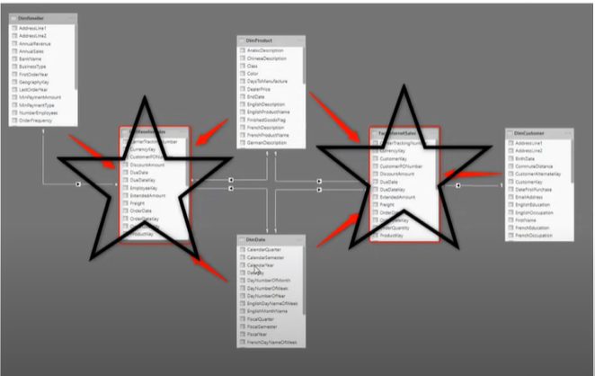
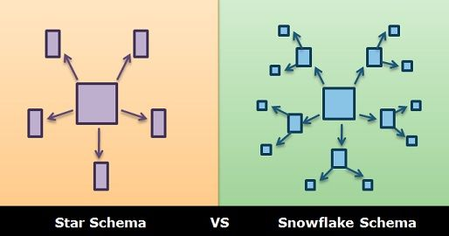
Designing a Data Model
Star Schema is not just one fact table !

Slide 5

Designing a Data Model
Remove unnecessary columns and rows
Identify poorly performing measures, relationships and visuals
Creating summarized tables
Improve cardinality
How to optimize a data model ?

Slide 6
DAX
Data Expression Language (DAX) is a library of functions and operators that can be combined to build formulas and expressions in Power BI.
DAX allows you to add new columns and measures to enrich your data sources and open potential for new insights
3 ways to use DAX
Calculated columns
Calculated measures
Calculated Tables
Where DAX can be used ?
Power BI
Power Pivot for Excel
SSAS Tabular Model
Azure Analysis Service

Slide 7
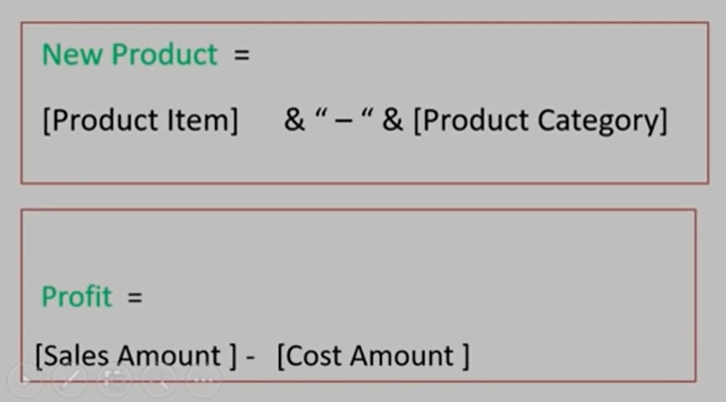
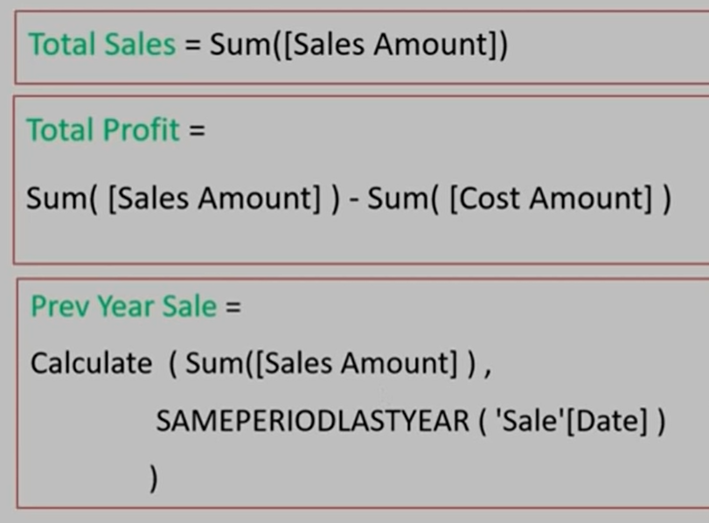
Calculated Columns vs Measures
Calculated Columns | Calculated Measures
Expands table by creating new columns | Summarizes data into a single value
Stored along with tables / Consume storage | Calculated at runtime / Consume RAM
Less analytical capabilities | Rich analytical capabilities
Calculated before aggregation | Calculated after the aggregation

Slide 8
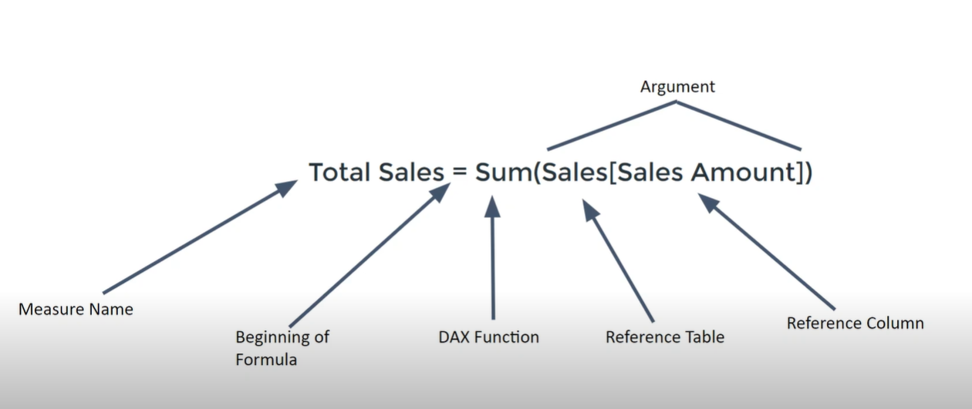
DAX Syntax

Slide 9
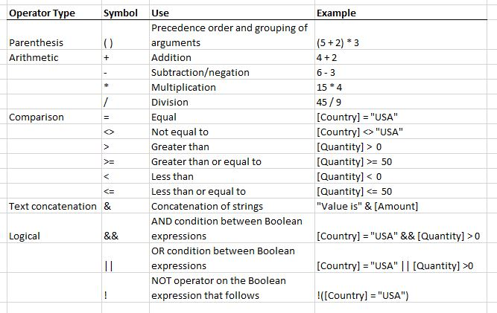
DAX Operators and Data Types
Text
Customer name
Age
Color
Whole number , Decimal
Quantity
Sales
Profit
Date Time , Date , Time
Sales Date
Birthday
TimeUTC
True / False
isValid
isTrue
Accepted

Slide 10
Types of DAX Functions
Aggregate Functions
Date and Time Functions
Time Intelligent Functions
Filter Functions
Financial Functions
Information Functions
Logical Functions
Math and Trig Functions
Other Functions
Parent and Child Functions
Relationship Functions
Statistical Functions
Table Manipulation Functions
Text Functions

Slide 11
Aggregate Functions – SUM vs SUMX
SUM , SUMX
SUMX - Returns the sum of an expression evacuated for each row in a table
SUM - Adds all the numbers in a column. Does not require row by row operation

Slide 12
What is CALCULATE function ?
CALCULATE , ALL
Compare total sales with main branch (united sales) sales ?
How much % each location is contributing to my sales ?

Slide 13
Time Intelligent Functions
TOTALMTD, TOTALQTD, TOTALYTD
What is cumulative sales quantity over Month, Quarter, Year ?
What is Financial Year cumulative sales quantity ?

Slide 14
Time Intelligent Functions
SAMEPERIODLASTYEAR
Returns a table that contains a column of dates shifted one year back in time from the dates in the specified dates column, in the current context.
How is my current year sales performing over last year ?

Slide 15
Time Intelligent Functions
PREVIOUSMONTH, PREVIOUSYEAR, PREVIOUSDAY, PREVIOUSQUARTER
How my products performing comparing to last month ?
How my products performing comparing to last year ?
How my products performing comparing to last day ?
How my products performing comparing to last quarter ?

Slide 16
Time Intelligent Functions
DATEADD
Returns a table that contains a column of dates, shifted either forward or backward in time by the specified number of intervals from the dates in the current context.
What is my sales compared to 14 days ago ?
What is my current sales compared to my business started year ?

Slide 17
Time Intelligent Functions
DATESINPERIOD, LASTDATE
How to calculate 3 month cumulative / moving average of sales ?
How to calculate 6 month cumulative / moving average of sales ?

Slide 18
Filter Functions
ALL , ALLEXCEPT
Creating a reference table
How much each category is contributing to total sales ?
How much each category is contributing to total sales for each country ?

Slide 19
Filter Functions
CALCULATE
Compare total sales with main branch (united sales) sales ?
How much % each location is contributing to my sales ?

Slide 20
Filter Functions
LOOKUPVALUE
Compare my product prices with competitor prices ?

Slide 21
Filter Functions
SELECTEDVALUE
Display monthly sales which allows to see all sales figures that occurred before a selected month ?

Slide 22
Logical Functions
IF , NESTEDIF, SWITCH
Logical functions can be used to check the result of an expression and create conditional results

Slide 23
Relationship Functions
CROSSFILTER , USERRELATIONSHIP
Used to manage and utilize relationships between tables

